Slide 1


Slide 2
Project Title
“WEB-BASED MONITORING AND TRACKING SYSTEM OF THE
RINALISA COOPERATIVE”

Slide 3
Introduction
The technological evolution is continuously proceeding leaving behind traditional means of storing and keeping track of data. Web - based monitoring and tracking systems are being considered to be a popular research topic in the field of IT related courses. A number of studies had been conducted, survey resulting in satisfaction and found that Web - based monitoring and tracking system is crucial in changing and leaving behind the traditional hand written documents stored and dura boxes, that some businessmen are considering it as a big step on widening the horizon of their business. This will reduce the burden of the staff that are tasked to monitor and keep track of written files of numerous numbers of members. This will also provide greater availability of information, and centralized security that will guarantee the growth of the cooperative.

Slide 4
Background of the Study
The developers gathered some data from the RINALISA Cooperative, that gave them the idea to propose and develop the monitoring and tracking system that will definitely help and improve the efficiency of the staff's work. Currently the cooperative is struggling on handling and keeping track of the 250+ members information, in addition the loan transaction is being more difficult for the staff and members to keep track of, it gave the developers an idea on improving the flow of data and information of transaction in terms of its availability to the staff and members. The web - based print function will resolve multiple information issues inside the cooperative, this will then further improve the efficiency of the loan transaction by providing a print that indicates the name of loan applicant, type of member, loan amount, duration (month), 10% interest rate, total amount, the start and end date of their loan. It will also indicate the date of when was the print given and the name of who printed the copy

Slide 5
SPECIFIC OBJECTIVES:
The main object of the study is to develop a Web - based management system that can help the RINALISA Cooperative in improving their means of recording and storing data and information of loan transaction inside the Cooperative

Slide 6
Providing a login form that allows the Administrator, Sub Administrator and Driver/Members are for viewing of their Data Information.
Allowing the Administrator to keep track of the members coop standing, records, Loan and monthly dues.
Providing the Sub Administrator with generated reports for reporting to the Administrator. The reports that are produced can be printed.

Slide 7
Convert and digitize any written records and information about Cooperative Members.
Improving the security of data and information
Developing a print function that will improve the availability of data and information of loan transaction
Increasing the work efficiency of the staff by reducing their burden in monitoring and tracking of data records.

Slide 8
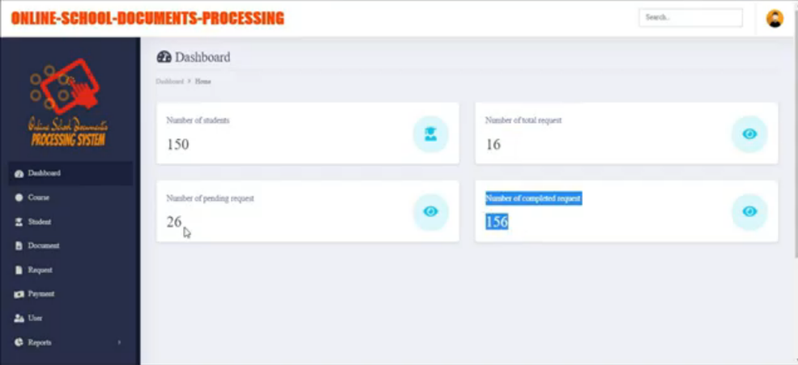
Related System
Student Offense Management System Capstone Project

Slide 9
Diagrams

Slide 10
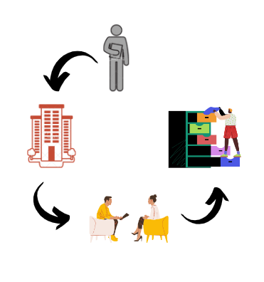
Current Technical Situation
Current Technical Situation

Slide 11

New Technical Situation
New Technical Situation

Slide 12
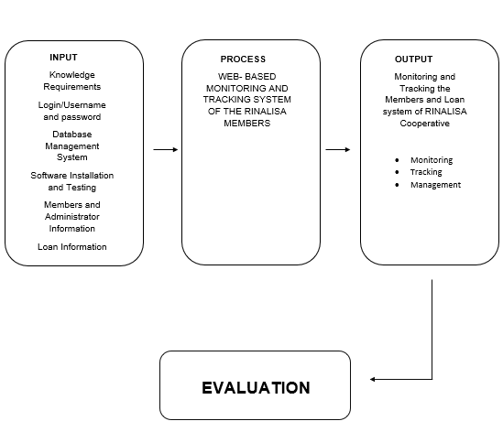
Conceptual Framework
Conceptual Framework

Slide 13
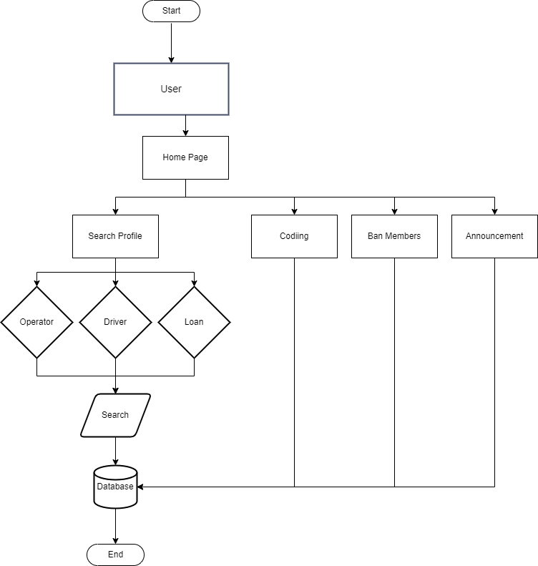
Flowchart
User Flowchart

Slide 14
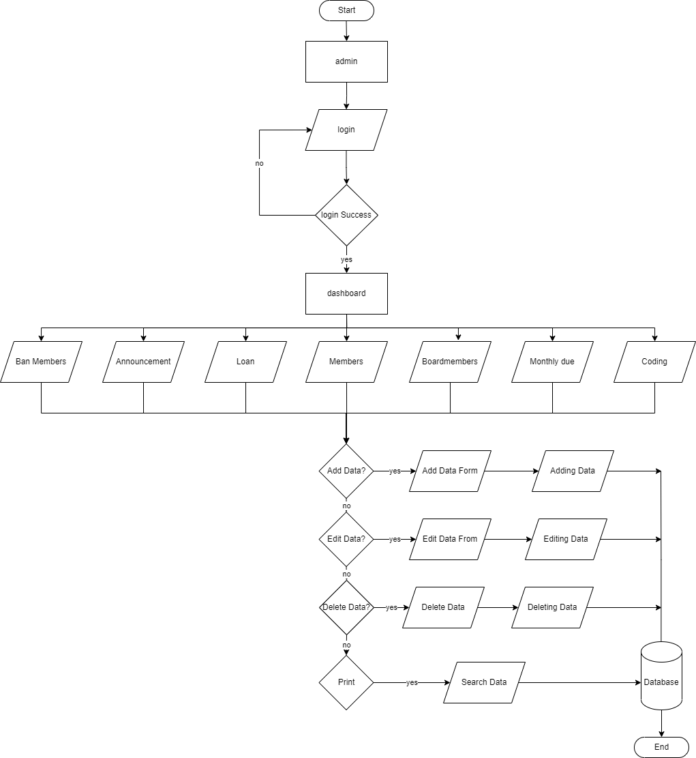
Admin Flowchart

Slide 15
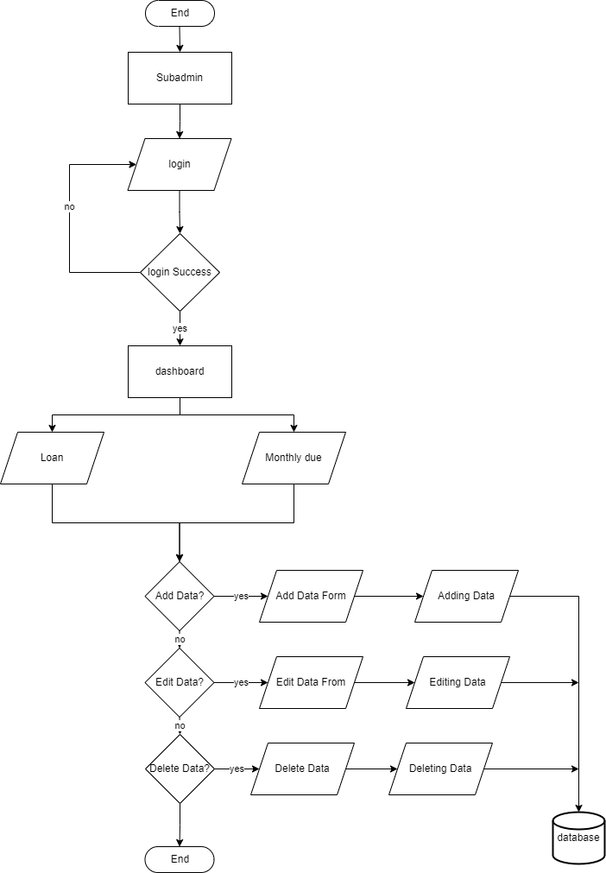
Sub-Admin Flowchart

Slide 16
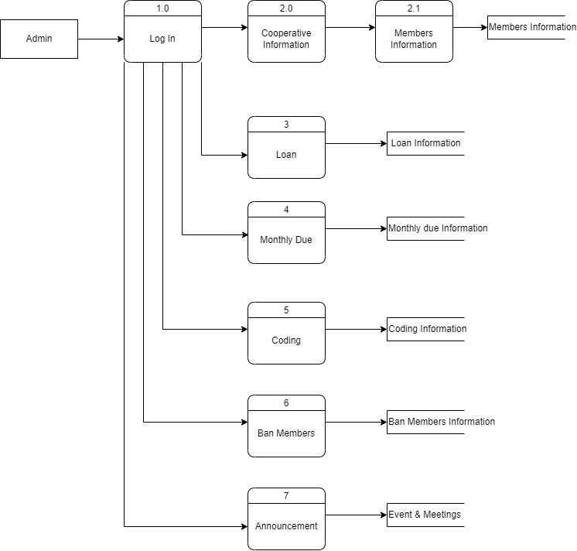
Data Flow Diagram
Data Flow Diagram (Admin)

Slide 17
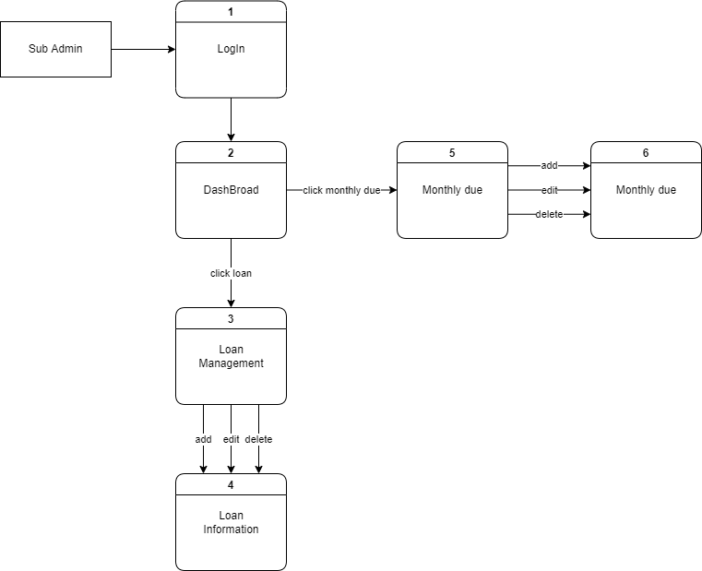
Data Flow Diagram (Sub-Admin)

Slide 18
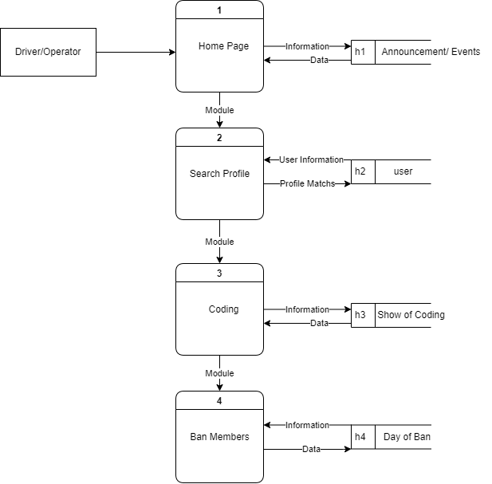
Data Flow Diagram (User)

Slide 19
Overall Evaluation
Software Quality Criteria | Client | IT Practitioners | Actual User | Average Mean | Interpretation
Functionality | 4.84 | 4.1 | 4.6 | 4.1 | Very Acceptable
Reliability | 4.8 | 3.8 | 4.53 | 4.38 | Very Acceptable
Usability | 4.6 | 4.7 | 4.57 | 4.2 | Very Acceptable
Efficiency | 4.8 | 4.3 | 4.45 | 4.52 | Highly Acceptable
Maintainability | 4.75 | 4.1 | 4.73 | 4.52 | Highly Acceptable
Portability | 4.8 | 4.3 | 4.68 | 4.59 | Highly Acceptable
Overall Mean | 4.76 | 4.21 | 4.59 | 4.38 | Very Acceptable

Slide 20
Recommendations
Based on the evaluation results of the project, the developers came up with the following recommendations:
The IT Professional propose that the admin dashboard should be changed to a more analytic design in which the numbers of data is sorted out, as well as the delete button notification warning for the deletion of data on the system, additionally slight improvement on the system design of the RINALISA TSMPC.

Slide 21
THANK YOU FOR LISTENING THAT IS ALL.

